Slide 1

Smart Fertilizer Spraying System Using Plant Disease Severity Analysis
Smart Fertilizer Spraying System Using Plant Disease Severity Analysis
by
Y Trinesh Reddy
Roll No. 234G5A3311
G Sreeja
Roll No. 224G1A33A9
B Revathi
Roll No. 224G1A3380
Y Sravani
Roll No. 224G1A33A4
Under the guidance of
Dr. C. Sasikala M.Tech., Ph.D.
Associate Professor
Department of Computer Science and Engineering (AI & ML)
Srinivasa Ramanujan Institute of Technology
(Affiliated to JNTUA & Approved by AICTE) (Accredited by NAAC with ‘A’ Grade & Accredited by NBA (EEE, ECE & CSE)
Rotarypuram Village, B K Samudram Mandal, Ananthapuramu – 515701.
2025 - 2026
B-10
Srinivasa Ramanujan Institute of Technology 1

Slide 2
Contents
Abstract
Introduction
Literature survey
Proposed Work
References
Applicationss
Conclusion
GitHub Link
Queries
B-10
Srinivasa Ramanujan Institute of Technology
2

Slide 3
Review-0 comments
Comment from Review–0:
The project was approved to proceed; however, it was suggested that the system should operate without direct human intervention during fertilizer spraying and should not be a wearable device for the farmer.
Action Taken:
Conducted a preliminary field-level study by interacting with farmers.
Eliminated the need for any wearable device for the farmer.
Implemented Bluetooth-based wireless communication for remote monitoring and control.
Srinivasa Ramanujan Institute of Technology
3

Slide 4
Abstract
The Smart Fertilizer Spraying System with Plant Disease Severity Analysis is an automated agricultural robot designed to enhance crop management through precision farming. The system employs a Raspberry Pi equipped with a USB camera to capture plant images and analyze disease severity using advanced image processing techniques. Based on the detected severity levels, the system dynamically regulates fertilizer spraying duration through three dedicated nozzles, ensuring precise application and minimizing wastage.
An Arduino microcontroller manages the operation of DC motors, water pumps, relays, and the robot chassis for efficient movement. Powered by a 12V battery and supported by a 9V solar panel, the system offers sustainable and energy-efficient operation. Bluetooth connectivity facilitates wireless monitoring and control. By combining disease severity detection with intelligent fertilizer management, this system reduces human intervention, optimizes resource utilization, and promotes eco-friendly farming practices
B - 10
Srinivasa Ramanujan Institute of Technology
4

Slide 5
Introduction
The Smart Fertilizer Spraying System with Plant Disease Severity Analysis is an automated agricultural robot developed to improve crop management through precision farming. The system uses a Raspberry Pi integrated with a USB camera to capture plant images and analyze disease severity using advanced image processing techniques. Based on the detected severity levels, the system automatically controls the fertilizer spraying process by adjusting the spray duration through three dedicated nozzles, ensuring accurate application while minimizing fertilizer wastage.
An Arduino microcontroller manages the robot’s movement and controls hardware components such as DC motors, water pumps, relays, and the chassis to enable efficient field navigation. The system is powered by a 12V battery supported by a 9V solar panel, providing sustainable and energy-efficient operation. Bluetooth connectivity allows wireless monitoring and control of the system. By integrating plant disease severity detection with intelligent fertilizer management, the proposed system reduces human intervention, optimizes resource utilization, and promotes eco-friendly and sustainable agricultural practices.
Srinivasa Ramanujan Institute of Technology

Slide 6
Literature Survey
Plant Disease Detection System for Smart Agriculture:
The Indian economy relies on agriculture to a great extent. In traditional agricultural practices, farmers identify crop diseases either through direct visual inspection or by consulting experts, sometimes by sharing diseased crop images through online services. However, continuous monitoring and assessment of disease severity cannot be performed manually, often leading to delayed treatment and increased crop loss.
In the plant disease detection system, the image to be tested is acquired, pre-processed, segmented, and analyzed to determine both the type of disease and its severity level. The classification and severity estimation are performed using a probabilistic linear classifier, namely the Naive Bayes algorithm. The system is developed using Android Studio, and python is used as the programming language.
The application identifies plant diseases based on pixel intensity analysis and evaluates the extent of disease spread (severity) on the affected leaves. Based on the detected severity level, the system predicts plant growth conditions and provides recommendations for appropriate fertilizers and pesticides. The developed system achieves an accuracy and its implementation reduces manpower requirements while improving productivity through timely and severity-based intervention.
.
Srinivasa Ramanujan Institute of Technology
6

Slide 7
Literature Survey
2. Crop Care – An AI-Integrated System for Smart Crop Protection and Disease Detection:
Agriculture plays a vital role in sustaining human life by ensuring food security for a growing population. However, plant diseases and improper fertilizer application often lead to reduced crop yield, economic losses, and environmental damage. To overcome these challenges, Crop Care proposes an AI-integrated automated agricultural robot designed to detect plant disease severity and perform precision fertilizer spraying without direct human intervention.
The system utilizes a Raspberry Pi integrated with a USB camera to capture real-time images of crops and analyze disease severity using advanced image processing and machine learning techniques. Based on the identified severity level, the system automatically regulates fertilizer spraying duration through three dedicated nozzles, ensuring accurate application while minimizing fertilizer wastage.
An Arduino microcontroller is employed to control the robot’s movement and manage hardware components such as DC motors, water pumps, relays, and the chassis, enabling efficient navigation across the field. The system is powered by a 12V battery supported by a 9V solar panel, ensuring energy-efficient and sustainable operation. Additionally, Bluetooth connectivity enables wireless monitoring and control of the robot.
By combining plant disease severity detection with intelligent and automated fertilizer management, the proposed system significantly reduces human effort, optimizes resource utilization, prevents overuse of fertilizers, and supports eco-friendly and sustainable farming practices.
Srinivasa Ramanujan Institute of Technology

Slide 8
Existing System
Traditionally, crop health monitoring and fertilizer application rely on manual inspection, where farmers visually examine plants to identify diseases, pests, or nutrient deficiencies and then apply fertilizer or pesticides using hand-operated or tractor-mounted sprayers.
This approach is labor-intensive, time-consuming, and prone to human error, often resulting in under- or over-application of chemicals. Additionally, uniform spraying without considering disease severity leads to wastage of resources and potential environmental harm. Compared to this traditional method, automated systems that integrate disease severity detection with targeted fertilizer application offer greater efficiency, accuracy, and sustainability.
Srinivasa Ramanujan Institute of Technology

Slide 9
Proposed System
The proposed Smart Fertilizer Spraying System integrates plant disease severity detection with precision fertilizer application to optimize crop management. The system uses a Raspberry Pi equipped with a USB camera to capture real-time images of plants. Image processing techniques are applied to analyze these images and determine the severity of detected diseases. Based on the severity level, the system intelligently adjusts the spraying duration of three separate nozzles, ensuring precise fertilizer application and minimizing waste.
An Arduino microcontroller controls the movement of the robot chassis, DC motors, water pumps, and relays to execute spraying operations efficiently. The system is powered by a 12V battery and supported by a 9V solar panel for sustainable operation. Bluetooth communication enables wireless monitoring and control, allowing farmers to track system performance and adjust settings remotely. This approach reduces human intervention, improves crop health, and promotes eco-friendly farming practices.
Srinivasa Ramanujan Institute of Technology

Slide 10
Components
Hardware Components:
Raspberry pi
Memory card
Usb web camera
Arduino
Solar panel 9v
Led
Dc motor 2
Robot chassis
Wheels-4
dc water pump-3
motor driver
relay-3
nozzle spraying-3
Bluetooth module
12v Battery
12v Adapter 2 amp
Software Components:
Arduino IDE
Embedded C
python
B-10
Srinivasa Ramanujan Institute of Technology

Slide 11
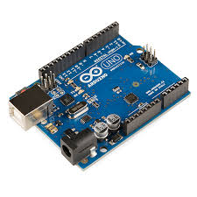
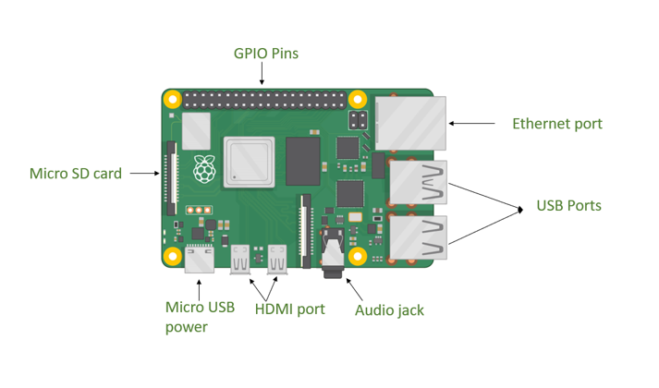
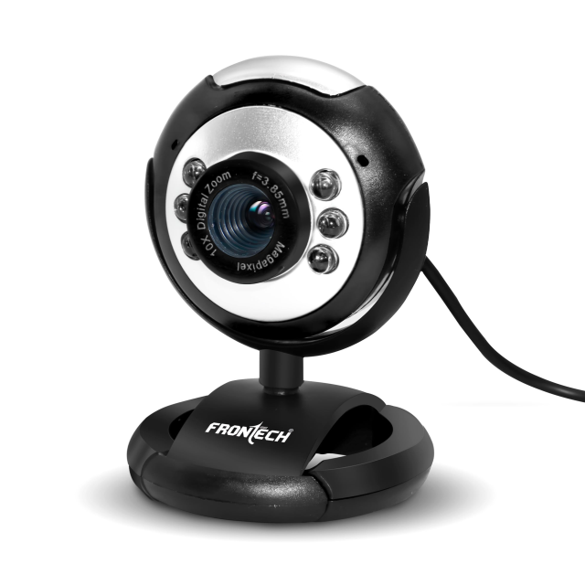
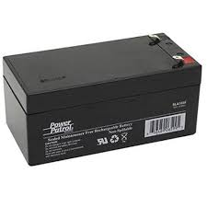
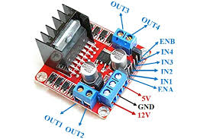
Components
Raspberry Pi
Web cam
Arduino Uno
Raspberry Pi:
12v Battery
Motor Driver
Srinivasa Ramanujan Institute of Technology

Slide 12
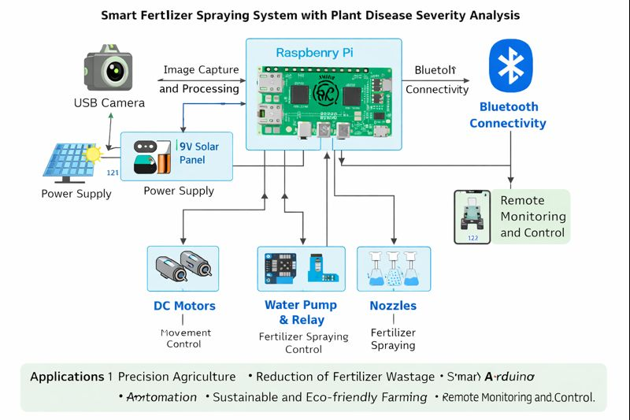
Block Diagram
Srinivasa Ramanujan Institute of Technology

Slide 13
Reference
Prakash M. Manikar, Shreekant Ghorpade, Mayur Adawadkar, "Plant Leaf Disease Detection and Classification Using Image Processing Techniques," International Engineering Journal, Volume 2, Issue 4, 2015.
2 Prof. Bhavana Patil, Mr. Hemant Panchal, Mr. SHUBHAM Yadav, Mr. Arvind Singh, Mr. Dinesh Patil, "Plant Monitoring Using Image Processing, Raspberry PI and IOT," Journal of Engineering and Technology, Volume 4, Issue 10, 2017
3 Navin V. Dumare, Prof. S. S. Mungona, "Identification of Cotton Leaf Diseases Using Raspberry PI," Volume 5, Issue 5, 2017, International Journal on Recent and Technology Trends in Computing and Communication.
Prathamesh. K. Kharde, Hemangi. H. Kulkarni, "A Special Method for the Detection of Grape Leaf Diseases," International Journal of Scientific Research, Volume 2, Issue 4, 2016.
Jayaprakash Sethupathy, Veni S, International Journal of Engineering and Technology, Volume 8, No 5, 2016, "Open CV Based Disease Detection of Mango Leaves."
Srinivasa Ramanujan Institute of Technology

Slide 14
Applications
Precision Agriculture – Automatically applies the right amount of fertilizer based on plant disease severity, improving crop health and yield.
Reduction of Fertilizer Wastage – Prevents overuse of fertilizers by spraying only where and when needed, saving cost and resources.
Smart Farming Automation – Reduces manual labor by automating disease detection, fertilizer spraying, and robot movement in agricultural fields.
Sustainable and Eco-friendly Farming – Uses solar power and optimized fertilizer usage to promote environmentally friendly agricultural practices.
Remote Monitoring and Control – Allows farmers to wirelessly monitor and control the fertilizer spraying system via Bluetooth for easy operation and decision-making.
B-10
B-10
Srinivasa Ramanujan Institute of Technology

Slide 15
Conclusion
The Smart Fertilizer Spraying System with Plant Disease Severity Analysis presents
an effective and innovative solution for modern precision agriculture. By
integrating image-based plant disease severity detection with automated fertilizer
spraying, the system ensures accurate and need-based application of fertilizers,
thereby reducing wastage and improving crop health. The coordinated operation of
the Raspberry Pi for image processing and the Arduino microcontroller for
hardware control enables efficient robot movement and reliable system
performance.
The use of solar-assisted power enhances sustainability, while
Bluetooth connectivity provides convenient wireless monitoring and control.
Overall, this system minimizes human intervention, optimizes resource utilization,
and supports eco-friendly farming practices, making it a promising approach for
improving agricultural productivity and sustainability in real-world farming
environments.
Srinivasa Ramanujan Institute of Technology

Slide 16
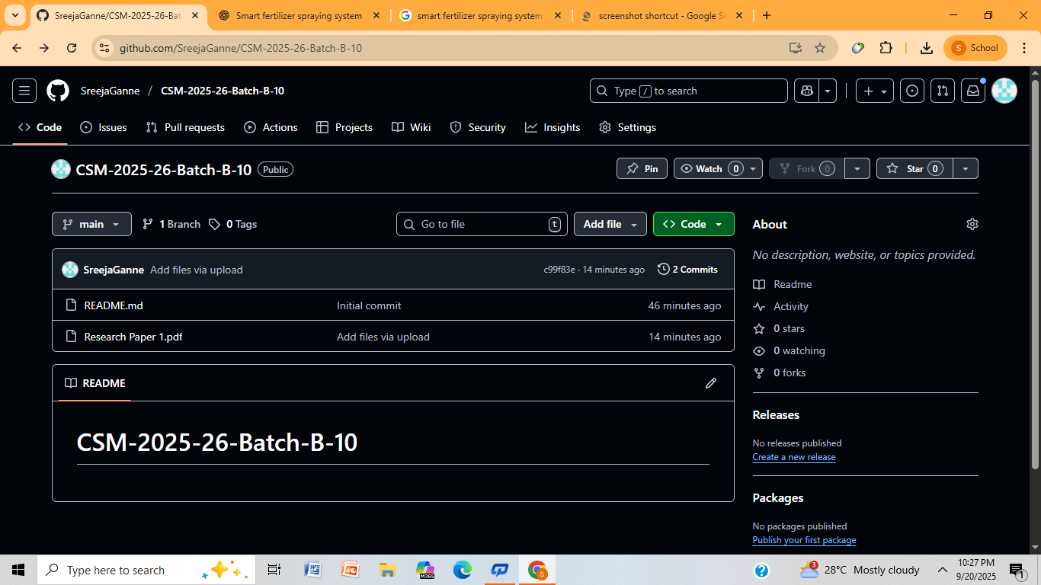
Git Hub Dashboard
Srinivasa Ramanujan Institute of Technology

Slide 17
Any Queries?
Srinivasa Ramanujan Institute of Technology

Slide 18
Thank You!!!
Srinivasa Ramanujan Institute of Technology

